Slide 1

A WEB PLATFORM FOR THE COMPARISON OF STRATEGIES IN A TRICK-BASED CARD GAME
Samuel Bor
14/03/2019 | CS310

Slide 2

Introduction

Slide 3
Introduction
Contract Whist
No accepted strategy to win consistently
This project aims to resolve this through agent simulation
Very few previous investigations on this Whist variant
Notes:
While we have played many games in the past, never have we agreed on an optimal strategy that yields the highest win rate.
This project aims to resolve this dispute by simulating the game being played by computer-controlled agents and recording the results in order to determine the most effective strategy.
There are also very few other investigations into this specific whist variant, so to be able to create a fully functioning game environment that agents can interact with - in the same capacity as humans can - is an exciting prospect.

Slide 4
Game Description

Slide 5
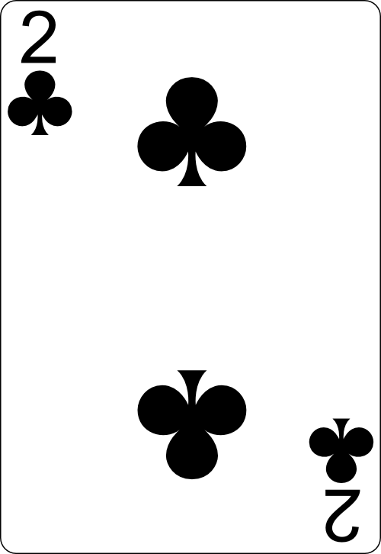

Contract Whist
Trick Taking Card Game

Slide 6
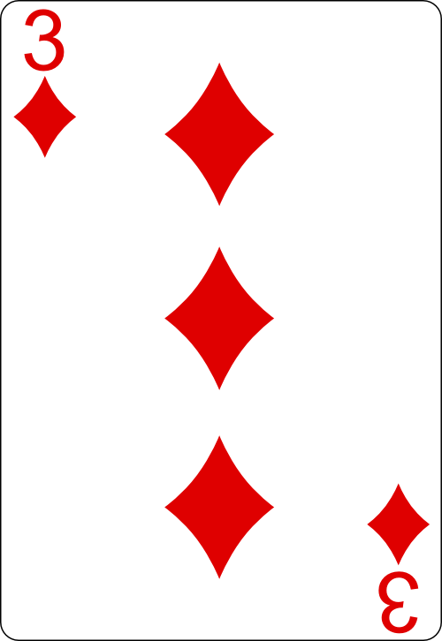
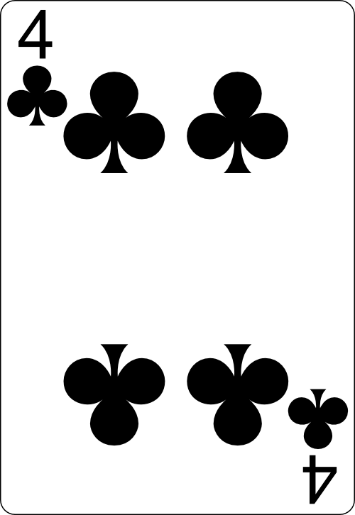
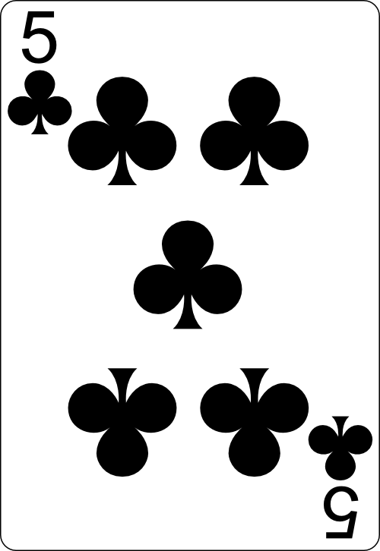
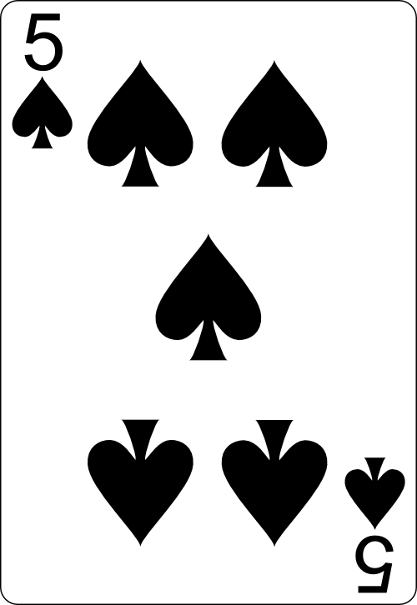
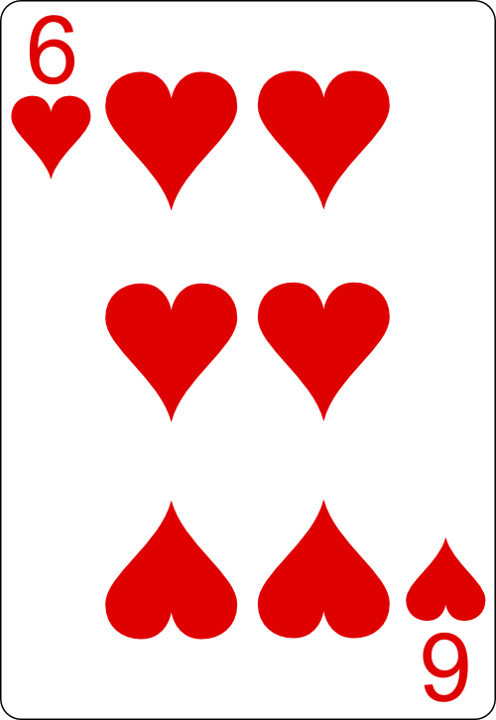
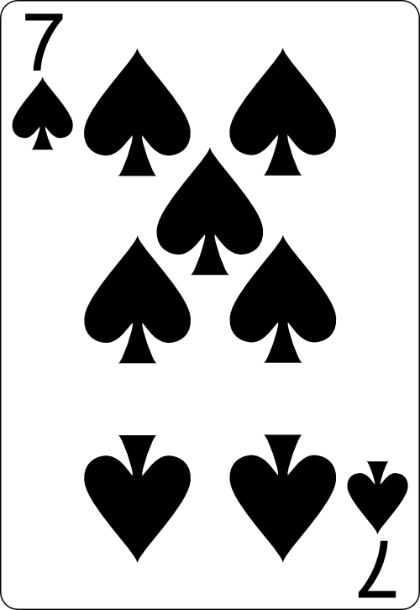
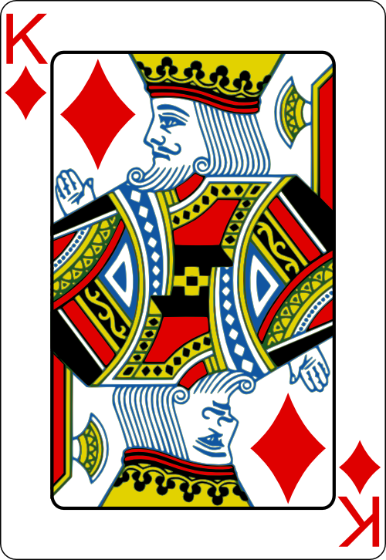
Contract Whist
Trick Taking Card Game
14 Rounds of Play

Slide 7
Bidding Stage
Players predict how many tricks they’re going to take
Based on a combination of card value and suit
Total number of tricks bid can’t equal the number of cards in the hand.

Slide 8
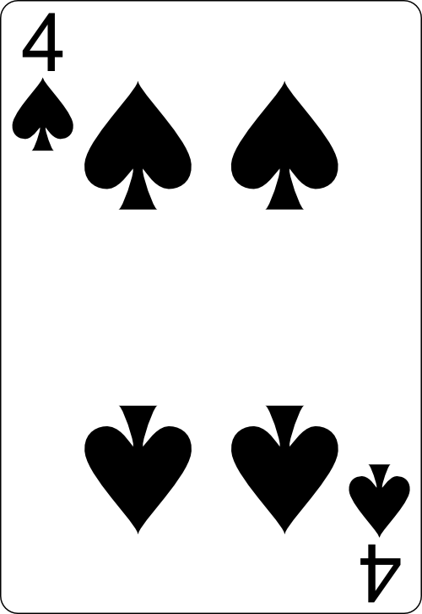

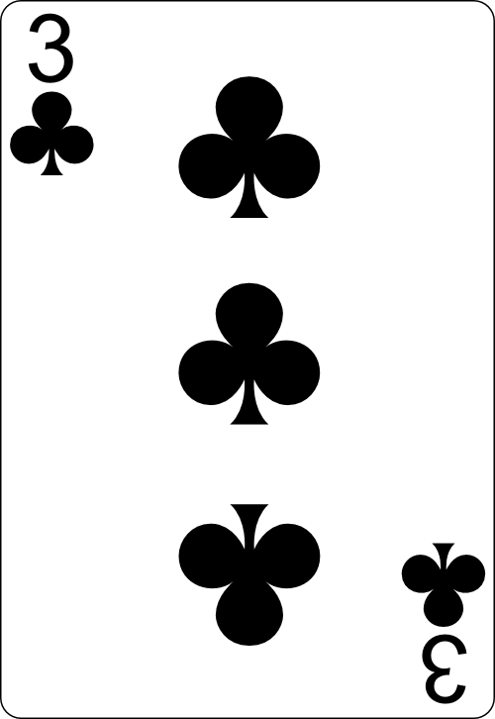
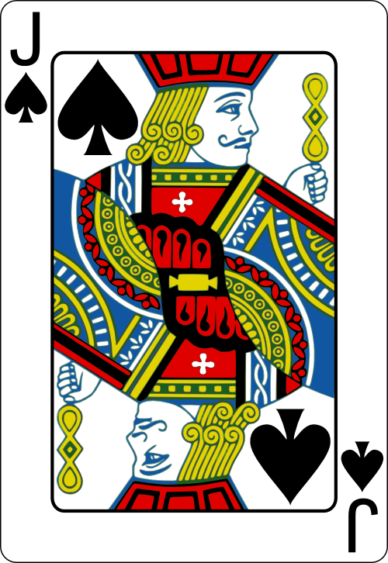
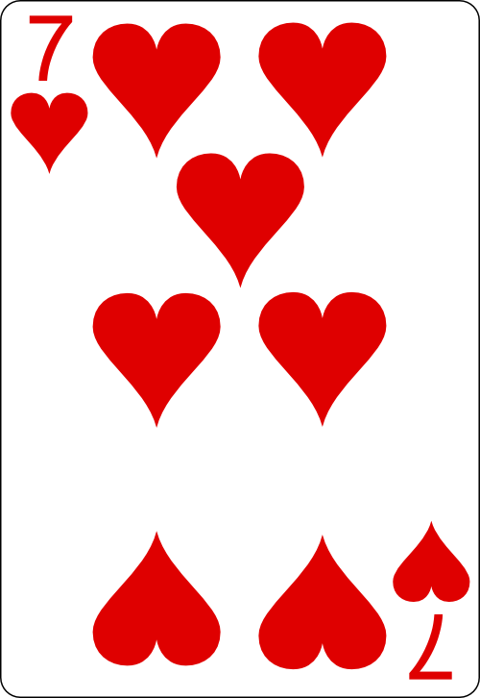
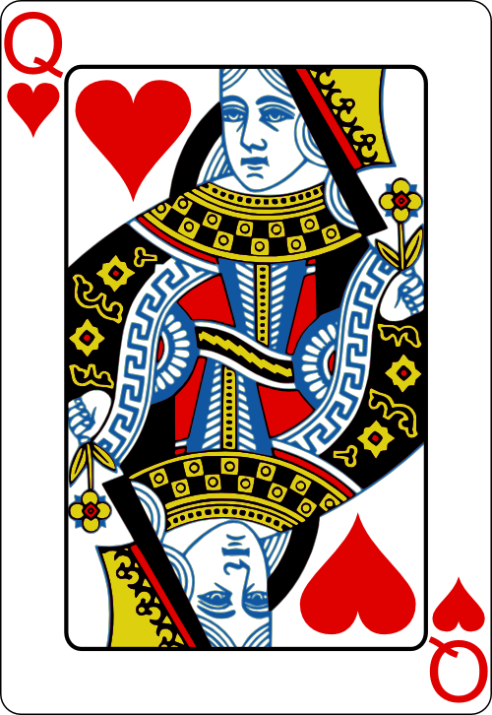
Bidding Stage
Total number of tricks bid can’t equal the number of cards in the hand.
2
1
!1

Slide 9
Gameplay Stage
Similar to regular trumps
Must follow the lead suit
Can only play a trump or “throw out” if a lead suit card is not possessed.

Slide 10
Scoring Stage
Comparing tricks won to tricks bid
Players lose 1 point for every trick they miss out on
Win 2 points for every trick they take
Bonus 10 points if they meet their contract exactly.

Slide 11
Background Material

Slide 12
Background Material
Very little pre-existing literature
Game can be generalised as:
Multi-Agent
Non-Deterministic
Partially Observable
Trick-Taking
Card Game

Slide 13
Background Material
“[Existing bridge programs] would have to improve to be hopeless” – Bob Hammam, 1994 [1]
25 years of change and improvements
Machine Learning would have previously been infeasible
Notes:
a lot of progress has been made in the last 25 years both in computational power and also in tools we now have at our disposal to solve previously infeasible problems.
For example, the machine learning library I make use of in my system handles the complicated prediction stage that’s vital for an accurate trick-predicting simulation.

Slide 14
Background Material
Determinization and information set Monte Carlo tree search for the card game Dou Di Zhu - Whitehouse, D., Powley, E.J. and Cowling, P.I. - 2011 [2]
“[a] recent innovation in AI for deterministic games … is Monte-Carlo Tree Search”
Ideal for partially observable environments
A 3 agent game limits the potential size of the simulated game tree
Notes:
An agent using this strategy will only have to look at most 2 children deep in the potential game tree which will have at most 52 nodes on each level.

Slide 15
Background Material
Developing an Artificial Intelligence for Whist – Fong, J – 2005 [6]
“…we can take a probabilistic approach and consider which card is most likely to lead to a favourable result.”
“A Monte Carlo method can then be used to make an educated guess as to which card will lead to [this] favourable result”
Inspiration for the Monte Carlo agent created for my system
Notes:
he allowed a fully observable assumption in order to reduce the branching factor of opponents moves to a feasible size to calculate a heuristic,

Slide 16

Play Contract Whist.com
[4]
Notes:
Working on application

Slide 17
Objectives

Slide 18
Objectives
To create a back-end application capable of simulating the Contract Whist game I’m familiar with.
To create a user-friendly front-end in order to show the simulation as it runs, and allow the user to interact where appropriate
To set up a web server to connect the front-end and back-end and to increase usability and exposure of the application
To implement 5 distinct agents in order to compare strategy effectiveness
To allow agents to predict the number of hands they’re going to win using a multi-class classifier, which I’ll elaborate on later in the presentation.

Slide 19
System Overview

Slide 20
Development
Back-end game code built in Java
Web server running on the Java Framework: Spark
Front end built in HTML, CSS and JS
Game code engineered as thread safe to facilitate concurrency
Notes:
engineering the game code to be thread-safe, allowing multiple concurrent users to run simulations independent of each other.
conducted a survey among my friends and colleagues

Slide 21
Machine Learning
“The process of a computer improving its performance by learning from past experiences”
The prediction stage required a way of predicting how many hands an agent would based only on past data.
Many different machine learning options, but Classification is the one most suitable for this task

Slide 22
Classification
“The process of defining distinct, non-overlapping classes that a dataset fits into and assigning unseen data into a class”
Classifier is trained using a training set
Then tested using an unseen test set
Features are the significant attributes that contribute to a classification

Slide 23
Support Vector Machine
“Solves pattern recognition problems by mapping the data into a higher dimensional input space and constructing an optimal separating hyperplane” [13]
Efficient at classifying linear attributes
The parameter c represents the trade-off between a large minimum margin between points and classes and correct separation of instances between classes [12]
Use of Self Optimising variant that optimises the parameter c with a focus on accuracy
Notes:
optimised to classify each record efficiently, even in a multiclass problem such as this.

Slide 24
Agents – MiniMax
Random Agent
Varying Trump Agent
Maximum Agent
MiniMax Agent
Monte Carlo Agent
Plays the lowest winning card in its hand when trying to win
Plays highest losing card when trying to lose
<

Slide 25
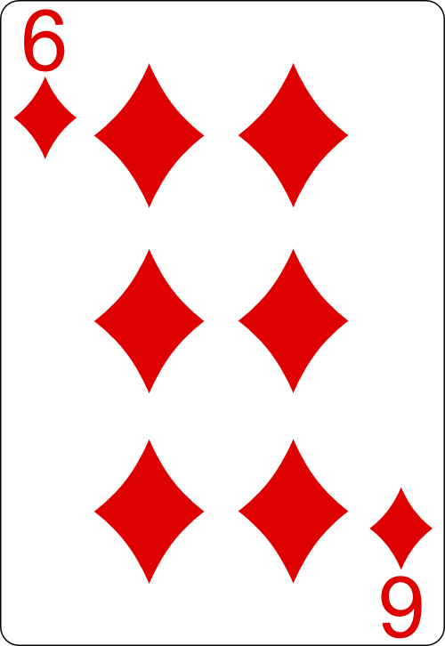
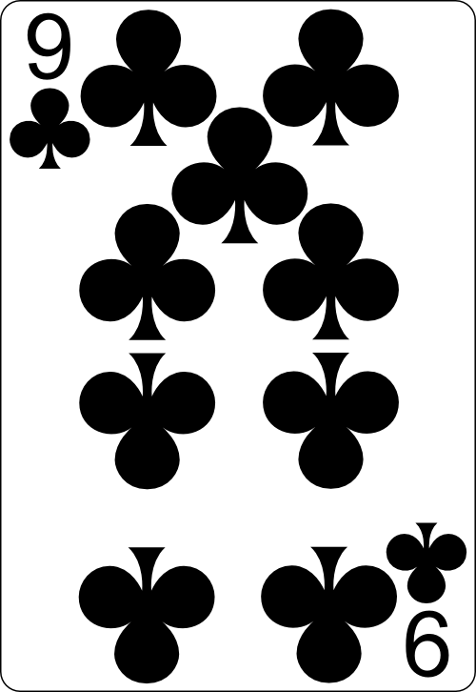
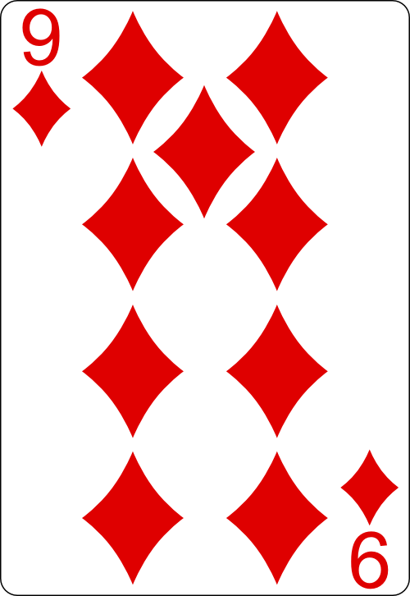
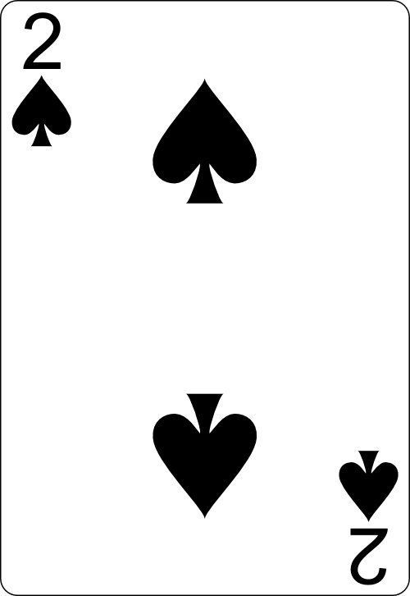
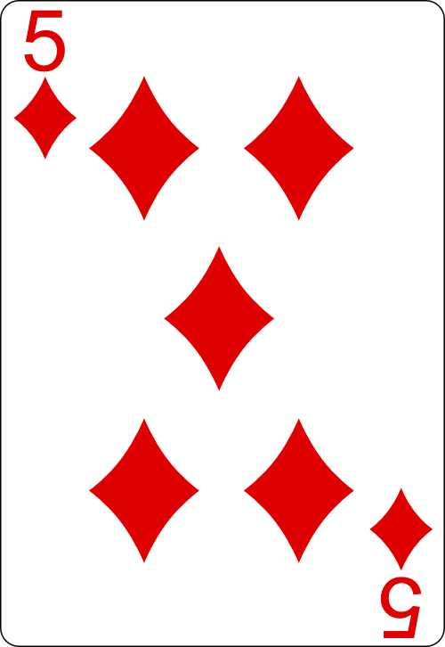
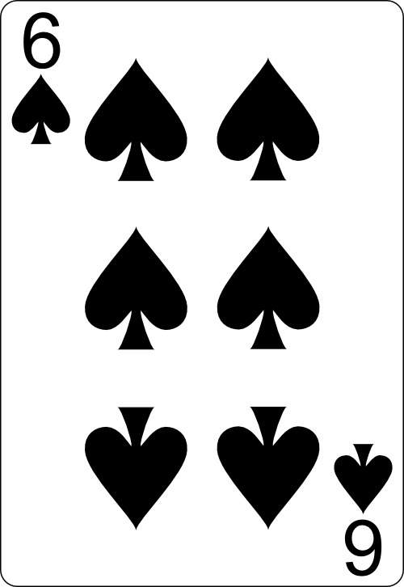
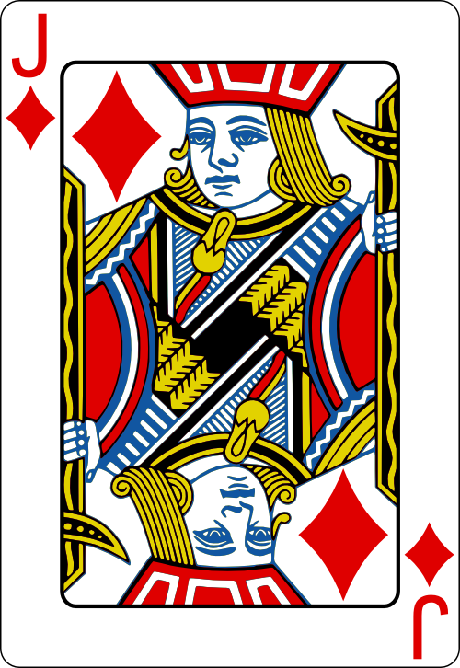
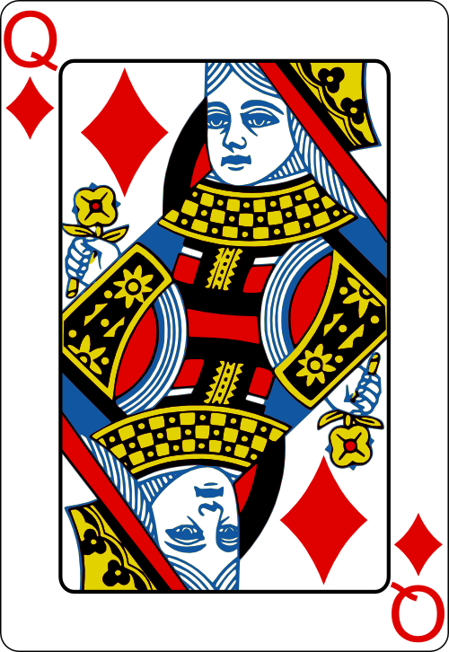
Agents
Random Agent
Varying Trump Agent
Maximum Agent
MiniMax Agent
Monte Carlo Agent
<

Slide 26
Agents
Random Agent
Varying Trump Agent
Maximum Agent
MiniMax Agent
Monte Carlo Agent
<

Slide 27
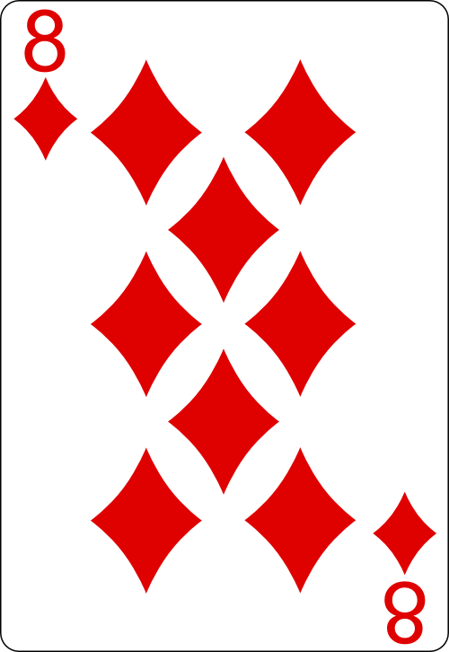
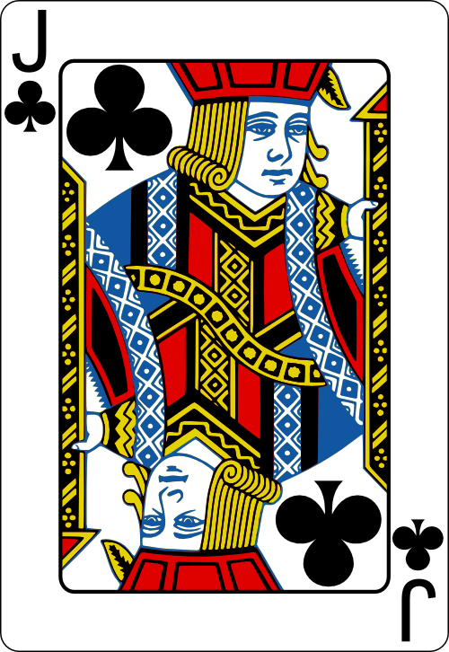
Agents
Random Agent
Varying Trump Agent
Maximum Agent
MiniMax Agent
Monte Carlo Agent
<

Slide 28
Agents
Random Agent
Varying Trump Agent
Maximum Agent
MiniMax Agent
Monte Carlo Agent
<

Slide 29
Agents – Monte Carlo
Random Agent
Varying Trump Agent
Maximum Agent
MiniMax Agent
Monte Carlo Agent
Builds on the MiniMax agent
Takes a probabilistic approach towards estimating win likelihood
Tracks all cards played in the current game
Calculates likelihood
<

Slide 30
Agents
Random Agent
Varying Trump Agent
Maximum Agent
MiniMax Agent
Monte Carlo Agent
<

Slide 31
Agents
Random Agent
Varying Trump Agent
Maximum Agent
MiniMax Agent
Monte Carlo Agent
<

Slide 32
Technical Challenges
Issues occurred while refactoring the game code to be thread-safe
Interface and Back-End struggled to cope with information leaking between game instances
Cause of issue tracked down to be the inclusion of static key word in places it shouldn’t be
Notes:
This marked the attributes that should be unique in each game as common, meaning the wrong data was being accessed and manipulated at every stage of the game

Slide 33
Agent Evaluation
Game stripped down to gameplay stage to properly evaluate strategies
Agent performances split them into 2 groups of effectiveness.
Results show a significant performance increase through use of Max and Minimax
Monte Carlo Agent
MiniMax Agent
Maximum Agent
Random Agent
VaryingTrump Agent

Slide 34
Agent Evaluation

Slide 35
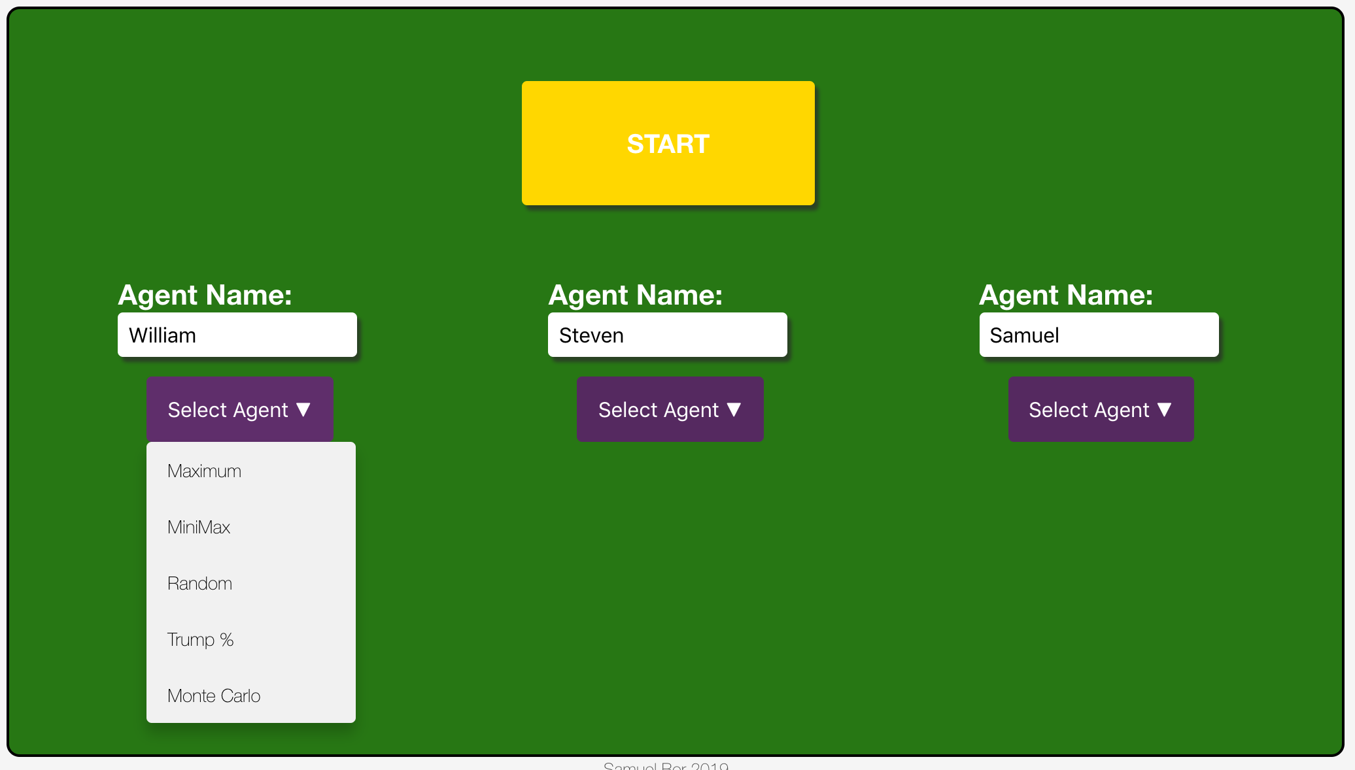
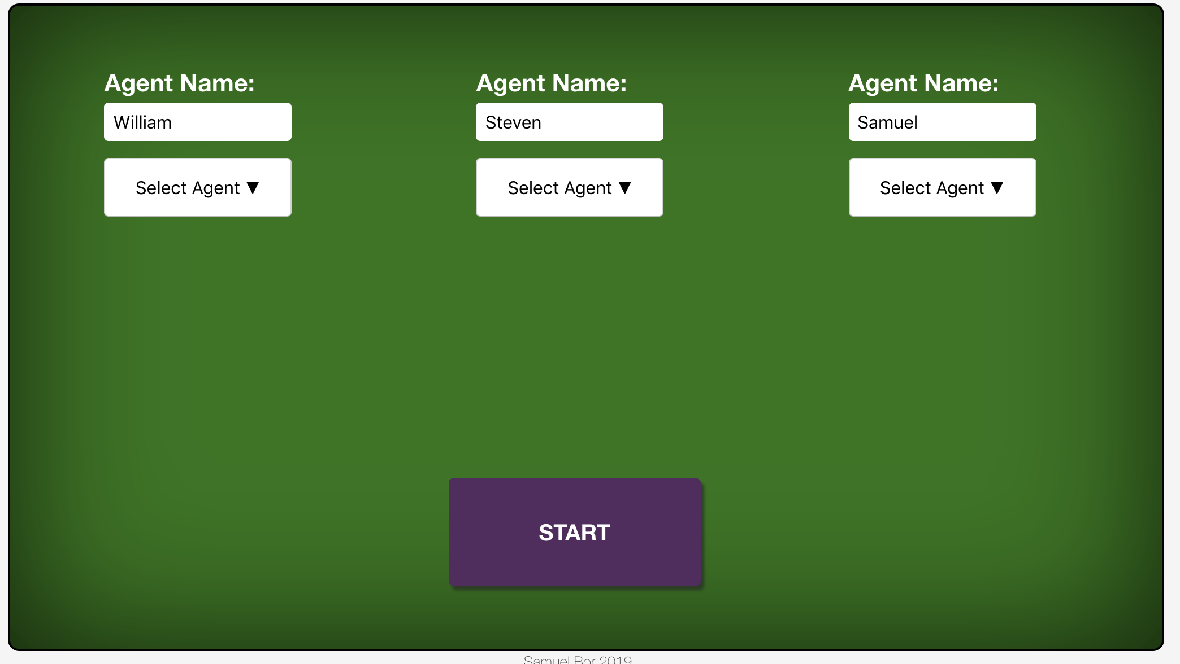
Survey Analysis
60% Aesthetic Satisfaction
99% Aesthetic Satisfaction

Slide 36
Project Management

Slide 37
Project Management
Weekly Supervisor Meetings helped to keep the project running consistently
Email and Slack used to for additional contact
Git used for Version Control, to allow for rollbacks if necessary

Slide 38
Methodology
Hybrid-Scrum approach followed through the project to keep workflow consistent.
Sprints planned ahead of time to ensure all work was finished in a timely manner
Notes:
ensure all aspects of the project were progressing at the same rate

Slide 39
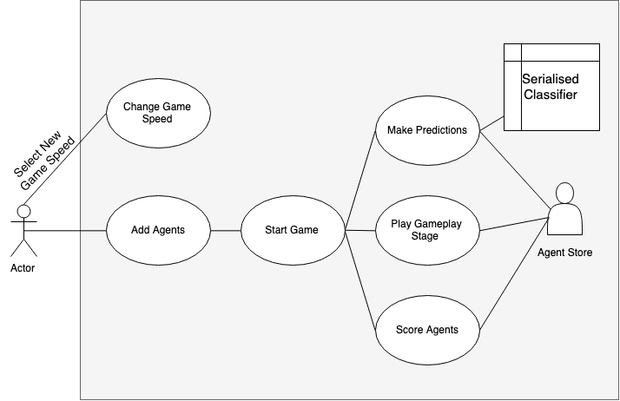
Use Case Diagram

Slide 40
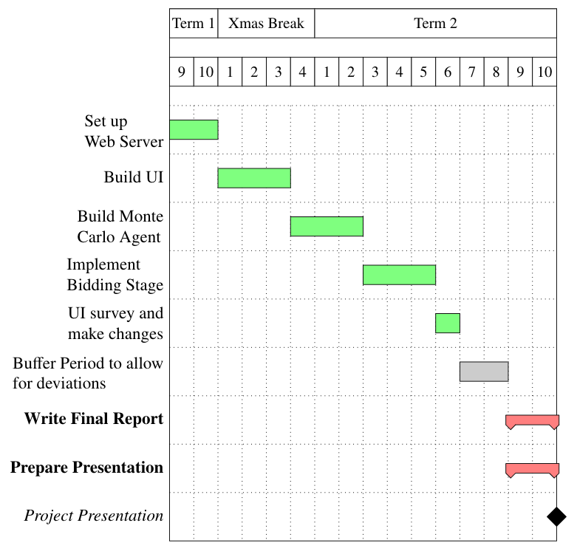
Gantt Chart
Notes:
is the Gantt chart I aimed to follow throughout the term
majority of the work was completed in a timely manner
planned my modules this year around my dissertation
buffer zone that I allowed myself allowed me to finish the software side of the project with plenty of time to spare,

Slide 41
Future Extensions

Slide 42
Future Extensions
Allowing a human in order to compare with agent abilities
Additional Agents for further testing, potentially with new assumptions
Create API such that users can write their own agents and test against the preloaded ones

Slide 43
Conclusion

Slide 44
Conclusion
Functional Application has been built
All 5 original objectives have been met
Agents tested and compared against one another
Monte Carlo strategy performs the best in theory over 1000s of games
Minimax is best to use in practice due to speed and simplicity

Slide 45
References
M.L. Ginsberg, “GIB: Imperfect information in a computationally challenging game,” Journal of Artificial Intelligence Research, vol. 14, 2001, pp. 303-358.
Whitehouse, D., Powley, E.J. and Cowling, P.I., 2011, August. Determinization and information set Monte Carlo tree search for the card game Dou Di Zhu. In 2011 IEEE Conference on Computational Intelligence and Games (CIG'11) (pp. 87-94). IEEE.
Browne, C.B., Powley, E., Whitehouse, D., Lucas, S.M., Cowling, P.I., Rohlfshagen, P., Tavener, S., Perez, D., Samothrakis, S. and Colton, S., 2012. A survey of monte carlo tree search methods. IEEE Transactions on Computational Intelligence and AI in games, 4(1), pp.1-43.
http://play.contract-whist.co.uk/
http://www.cs.huji.ac.il/~ai/projects/2015/Whist/
Fong, J., 2005. Developing an Artificial Intelligence for Whist. University of California, Computer Science, Los Angeles.
Smith, S.J., Nau, D. and Throop, T., 1998. Computer bridge: A big win for AI planning. Ai magazine, 19(2), pp.93-93.
Alpaydin, E., 2009. Introduction to machine learning. MIT press.
Duda, R.O., Hart, P.E. and Stork, D.G., 2012. Pattern classification. John Wiley & Sons.
http://java-ml.sourceforge.net/
Hsu, C.W. and Lin, C.J., 2002. A comparison of methods for multiclass support vector machines. IEEE transactions on Neural Networks, 13(2), pp.415-425.
Kent Munthe Caspersen (https://stats.stackexchange.com/users/63785/kent-munthe-caspersen), What is the influence of C in SVMs with linear kernel?, URL (version: 2015-06-28): https://stats.stackexchange.com/q/159051
Suykens, J.A. and Vandewalle, J., 1999. Least squares support vector machine classifiers. Neural processing letters, 9(3), pp.293-300.
Notes:
References Screen - Demo then return for questions

